Slide 1



Slide 2



 | Slope Bins 4 | Smear Count 25
Block number | Alpha w/ Henderson Hasselbalch | Chi Chi_max = 2.2
[0 50] | 0.040012 | 1.160000
[50 75] | -0.278451 | 0.720000
[75 125] | -0.519707 | 0.608000
[125 156] | -0.154453 | 0.529032

Slide 3


 | Slope Bins 4 | Smear Count 31
Block number | Alpha w/ Henderson Hasselbalch | Chi Chi_max = 2.2
[0 31] | 0.001103 | 0.922581
[31 62] | -0.386873 | 0.703226
[62 93] | -0.290146 | 0.967742
[93 496] | 0.037164 | 1.098759
[496 527] | -0.064533 | 0.819355
[527 620] | 0.010682 | 0.756989
[620 647] | -0.103326 | 0.696296

Slide 4
Binary results

Slide 5







For i as L and H:
Pure height profiles
Mixed height profiles
Current L library
Current H library
Skip; marginal increase in vol prob not enough
Move onto chi3.0; larger NFL vol library

Slide 6





NFL
All plotting wrong L pure; look only at purp
NFH
H volume too low to neutralize L (v = 31 nm3/c)

Slide 7







H volume v = 60 nm3/c

Slide 8







H volume too low to neutralize L

Slide 9








NFH, V = 70

Slide 10





NFH & NFL v = 0.15
a2D
b1D
g1D

Slide 11





Based on NFH b5v15c3, apply VL = VH
NFL and NFH are from same amino acids but diff chain lengths. Should VL = VH?
L30 / H70
L80 / H20
L30 / H70
L80 / H20

Slide 12




L30 / H70
L80 / H20
L30 / H70
L80 / H20

Slide 13
L Fitting

Slide 14


VL = VH

Slide 15







Try b change, v same as H (0.15)
Phi unrealistic (?)
Phi unrealistic
Phi very unrealistic
Phi very unrealistic

Slide 16






Try similar params to H
5.6
11.2
16.8
28
56
7.5
11.25
18.75

Slide 17







Try similar params to H, b0.36
7.8
15.6
23.4
31.2
Unrealistic vol
Not very sensitive to v; not high enough to intersect neighboring chains (function of b and sigma)

Slide 18


Continuation from prev params

Slide 19







v2.7 and some fine
b1.50 v2.7 c3.2
b1.75 v2.7 c3.2
b1.75 v2.5 c3.2
b1.75 v2.5 c3.0
b2.0 v2.7 c3.2
b2.25 v2.7 c3.2
b2.50 v2.7 c3.2
Phi too small to decrease v0

Slide 20










b2.0 v10.0 c3.0
b2.0 v8.0 c3.0
b2.0 v6.0 c3.0
b2.0 v4.0 c3.0
b2.0 v2.0 c3.0
Phi limit
b1.8 v10.0 c3.0
b1.8 v8.0 c3.0
b1.8 v6.0 c3.0
b1.8 v3.0 c3.0
b1.8 v2.0 c3.0
Phi limit

Slide 21





b1.6 v10.0 c3.0
b1.6 v8.0 c3.0
b1.6 v6.0 c3.0
b1.6 v2.0 c3.0
b1.6 v1.5 c3.0
Phi limit

Slide 22


Response to stimuli given composition
Same data
Effect of composition given environment

Slide 23


NFL, pH 7.44, phos 1.5e (locs from LCMS)
Non-phos NFL
Block number | Alpha w/ Henderson Hasselbalch | Chi Chi_max = 3.2
[0 50] | 0.040012 | 1.540000
[50 75] | -0.278451 | 0.960000
[75 125] | -0.519707 | 0.868000
[125 156] | -0.154453 | 0.690323
 | Slope Bins 4 | Smear Count 25
Block number | Alpha w/ Henderson Hasselbalch | Chi Chi_max = 3.2
[0 50] | -0.019988 | 1.540000
[50 75] | -0.278451 | 0.960000
[75 125] | -0.519707 | 0.868000
[125 156] | -0.154453 | 0.690323

Slide 24


NFH, pH 7.44, phos 1.5e (locs from LCMS)
 | Slope Bins 4 | Smear Count 36
Block number | Alpha w/ Henderson Hasselbalch | Chi Chi_max = 3.2 | Chi Chi_max = 3.0
[0 36] | 0.000945 | 1.266667 | 1.20000
[36 72] | -0.527455 | 0.900000 | 0.85000
[72 324] | -0.208376 | 1.729365 | 1.628571
[324 396] | -0.111195 | 1.416667 | 1.333333
[396 432] | -0.152824 | 1.344444 | 1.266667
[432 647] | -0.033955 | 1.077209 | 1.015814

Slide 25

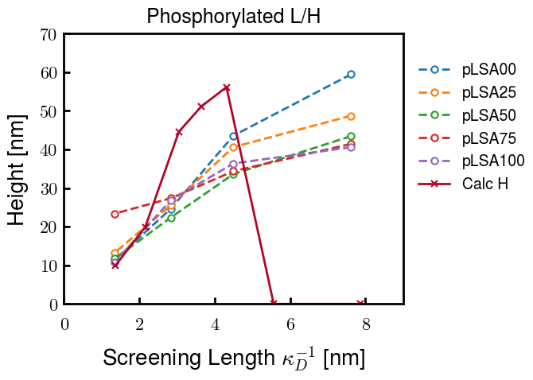
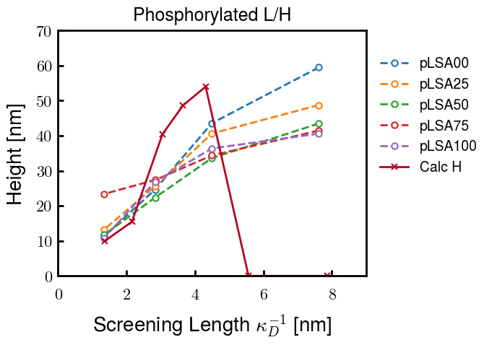
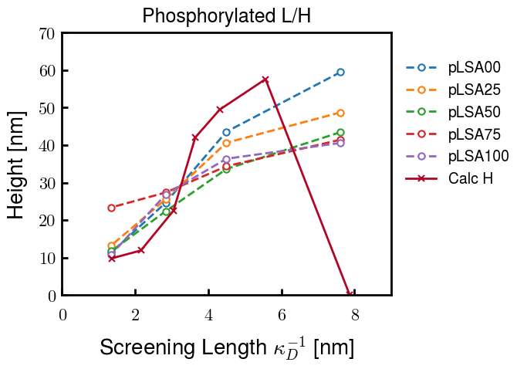
Instead of fitting b/v, could just change value of charge on phos. Try both and see if makes difference for mixture

Slide 26









b2.0 v2.7 c3.2
b3.0 v3.5 c3.5
b3.0 v7.0 c3.5
b3.0 v7.0 c3.0
Phi too small
Phi too small to decrease v0
b4.0 v12.0 c3.0
b5.0 v20.0 c3.0
b5.0 v20.0 c4.0
b5.0 v5.0 c3.0
b5.0 v10.0 c3.0
Phi too small to decrease v0

Slide 27





v20
b5.0 v20.0 c3.0
b4.5 v20.0 c3.0
b4.0 v20.0 c3.0
b3.5 v20.0 c3.0
v10
b5.0 v10.0 c3.0
b4.0 v10.0 c3.0
b3.0 v10.0 c3.0
b2.0 v10.0 c3.0

Slide 28




b2.00 v2.70 c3.20
b2.00 v2.75 c3.20

Slide 29
NFH fitting (from NFL best fit)

Slide 30








b1.00, v0.50, c3.2
b2.00, v4.00, c3.2, th2.5e-02
b1.00, v2.00, c3.2
b1.00, v1.00, c3.2

Slide 31
Mixture

Slide 32



Slide 33


b = 0.75

Slide 34





Slide 35
b = 1.0

Slide 36





Slide 37
b = 1.25

Slide 38




Chi 2.6
Bad vol frac

Slide 39








b25v0
b25v1
b25v2
b25v3

Slide 40




Chi 2.8
Bad vol frac

Slide 41





Slide 42
b = 1.50

Slide 43






Chi 2.8
Bad vol frac

Slide 44





Slide 45

b = 2.00
v4 = 0.25*b^3

Slide 46


Bad vol frac

Slide 47



Slide 48
Fine tune

Slide 49



b1.25, v1.95, c3.0
b1.50, v3.38, c3.0
b2.00, v4.00, c3.0
Norm seems to capture kinked behavior

Slide 50




Slide 51



b1.25, v1.95, c3.2
b1.50, v3.38, c3.2
b2.00, v4.00, c3.2

Slide 52




Slide 53


b1.25
b1.50
b2.00
c2.8
c3.0
c3.2

